Slide 1
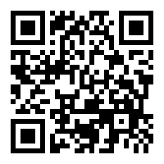
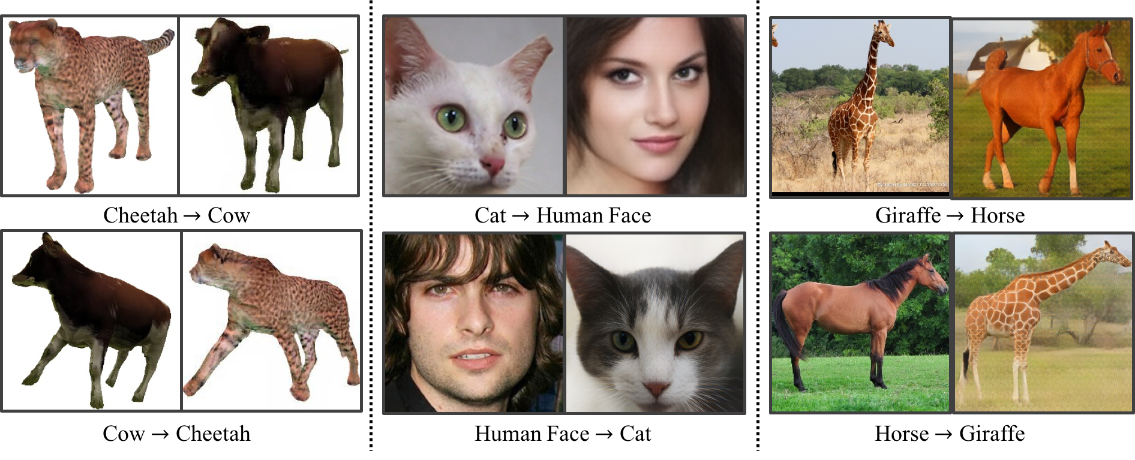
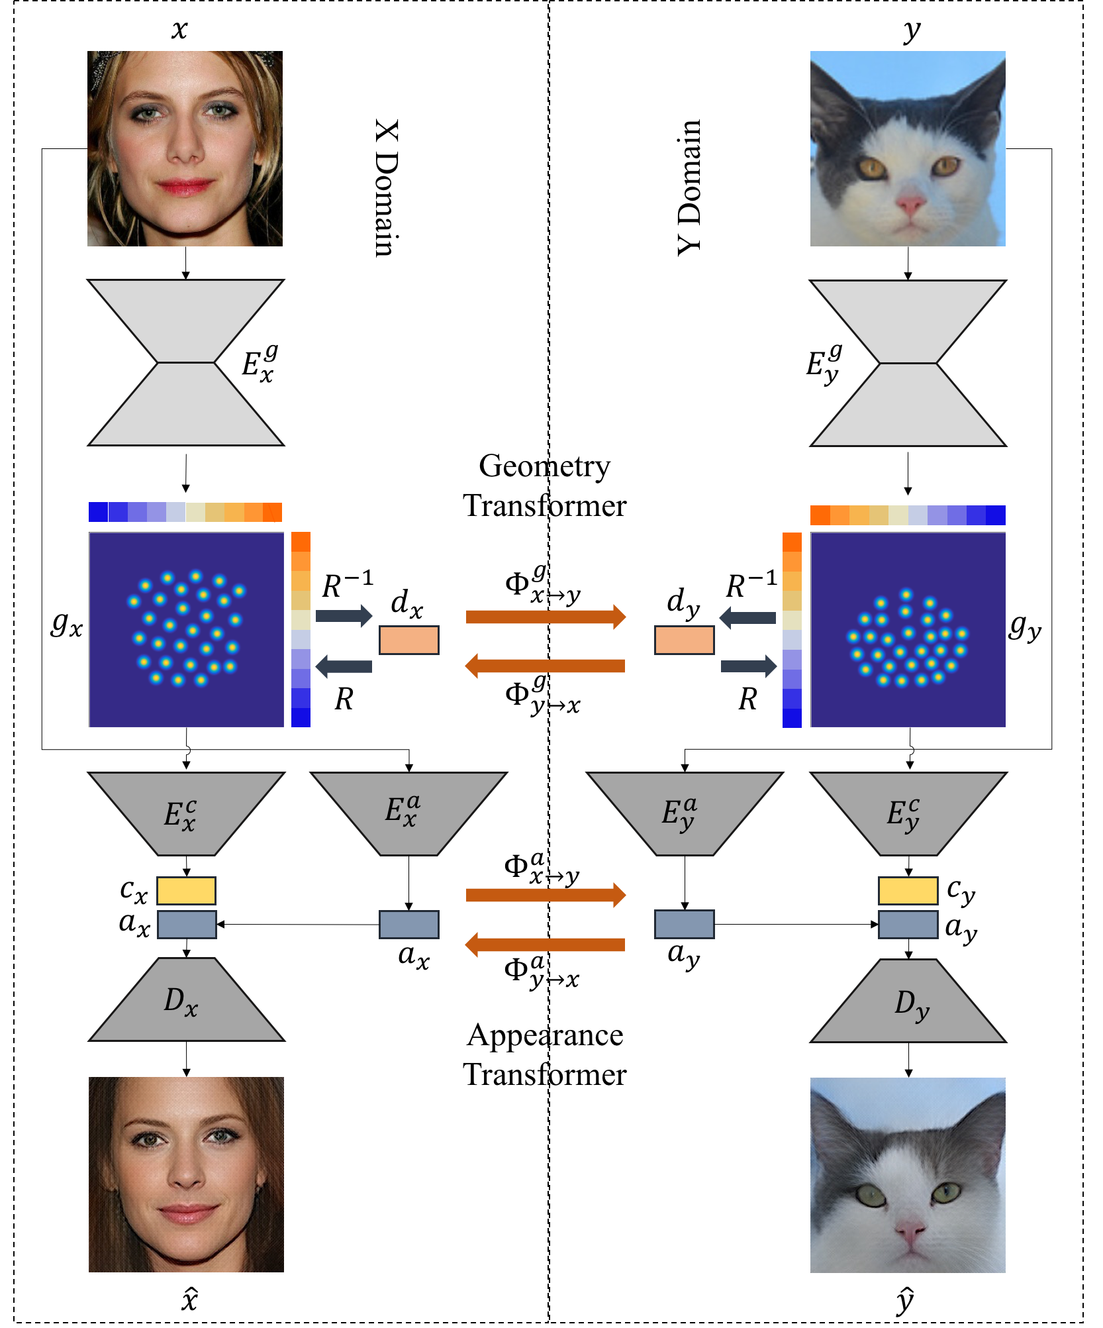
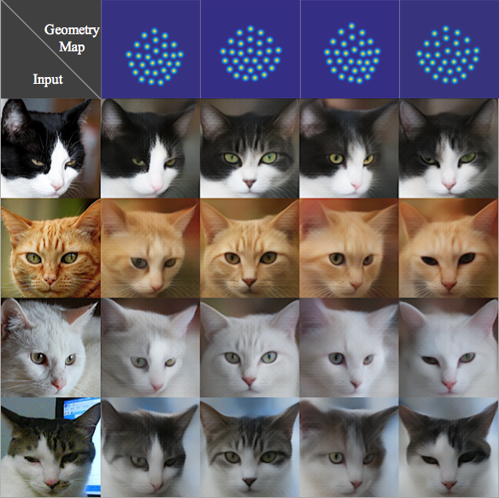
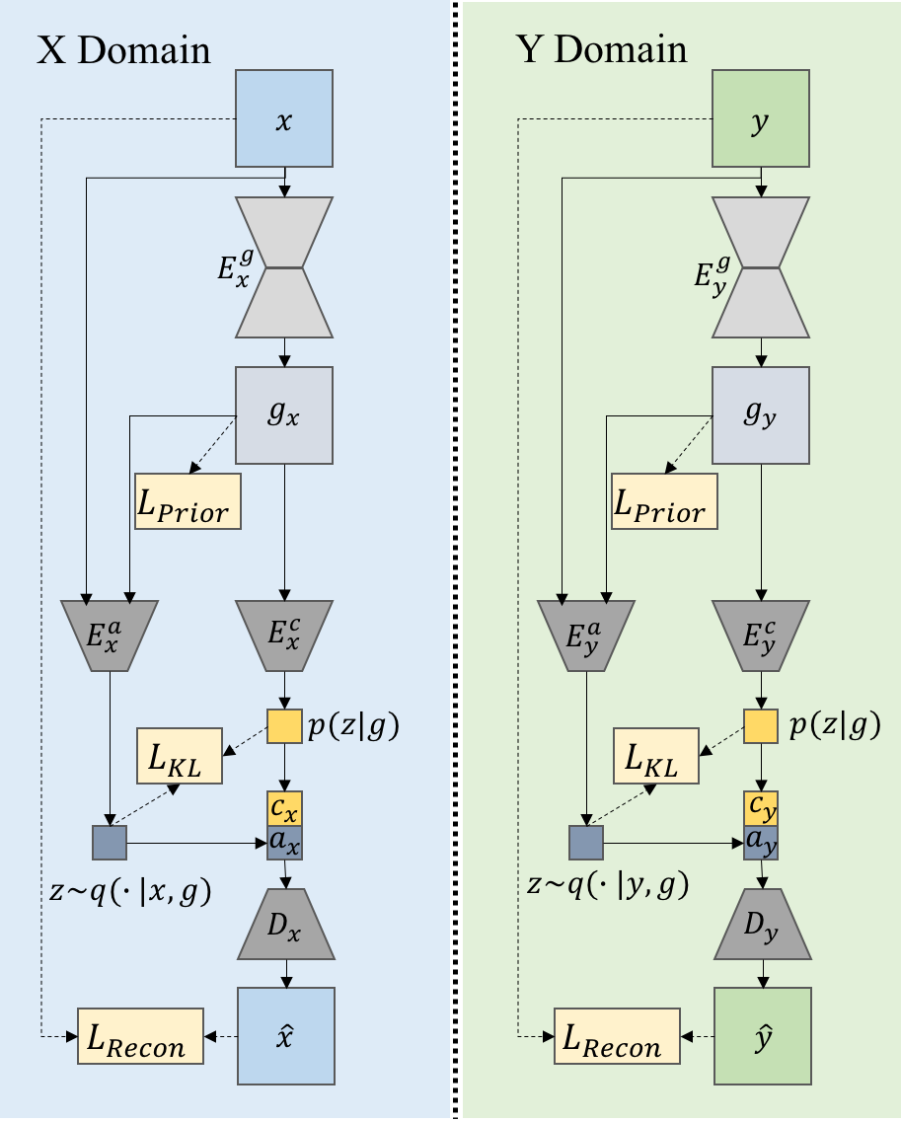
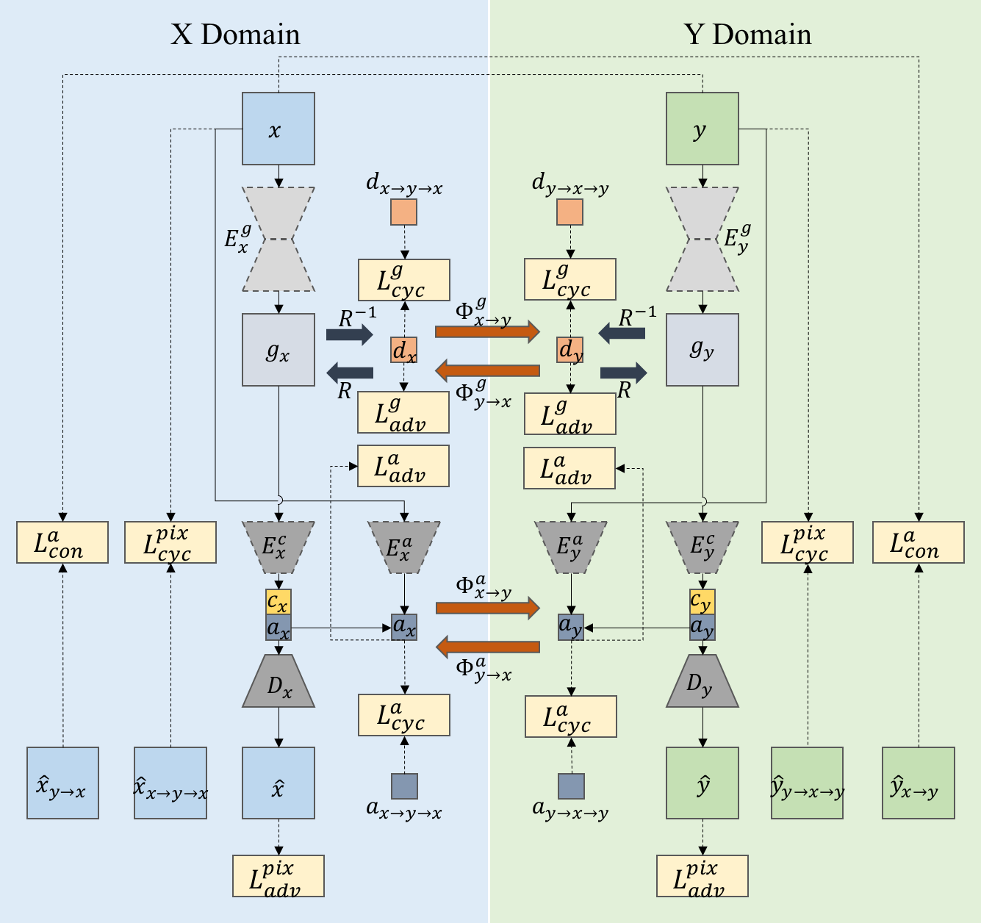
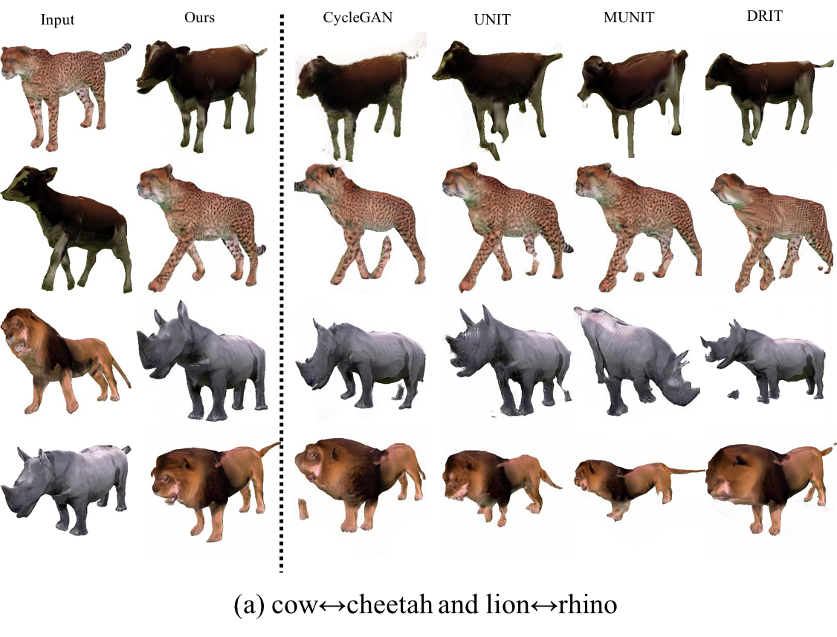
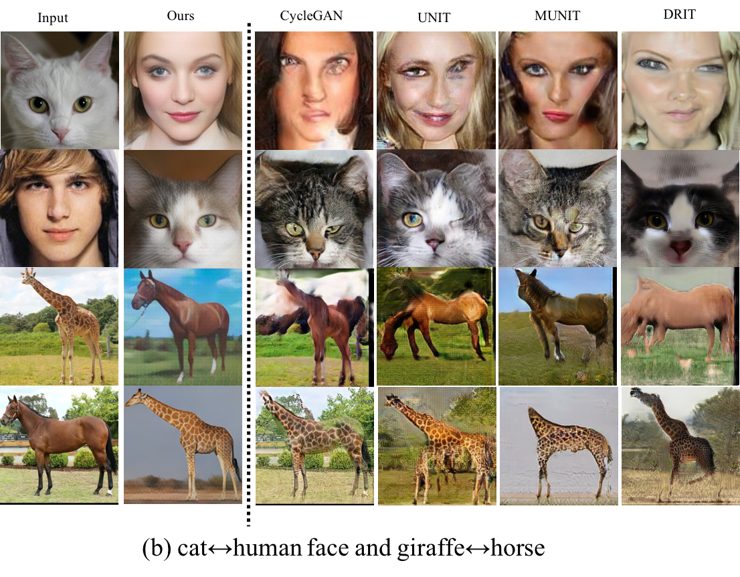
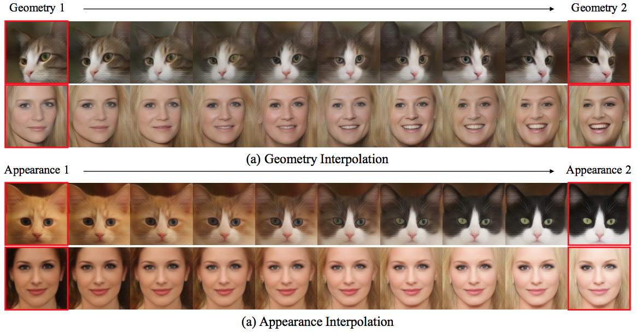
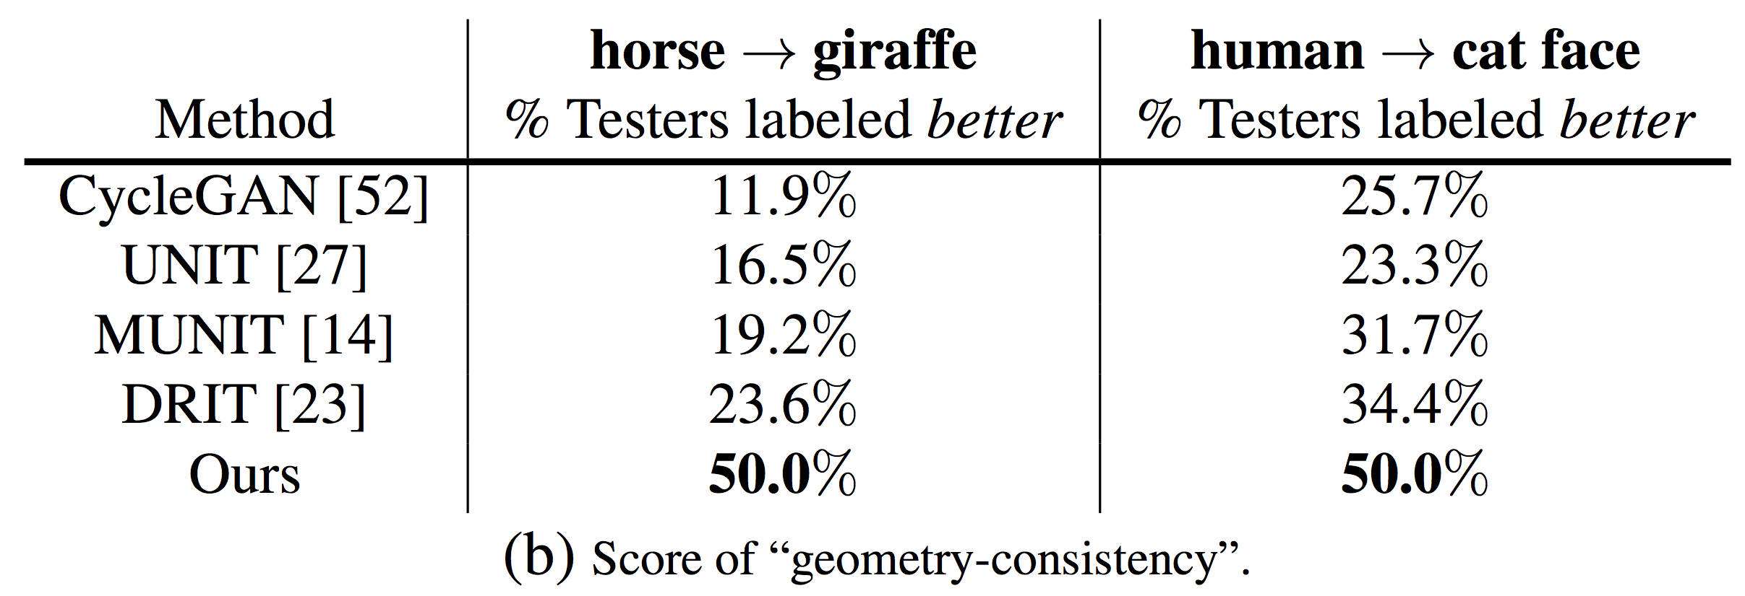
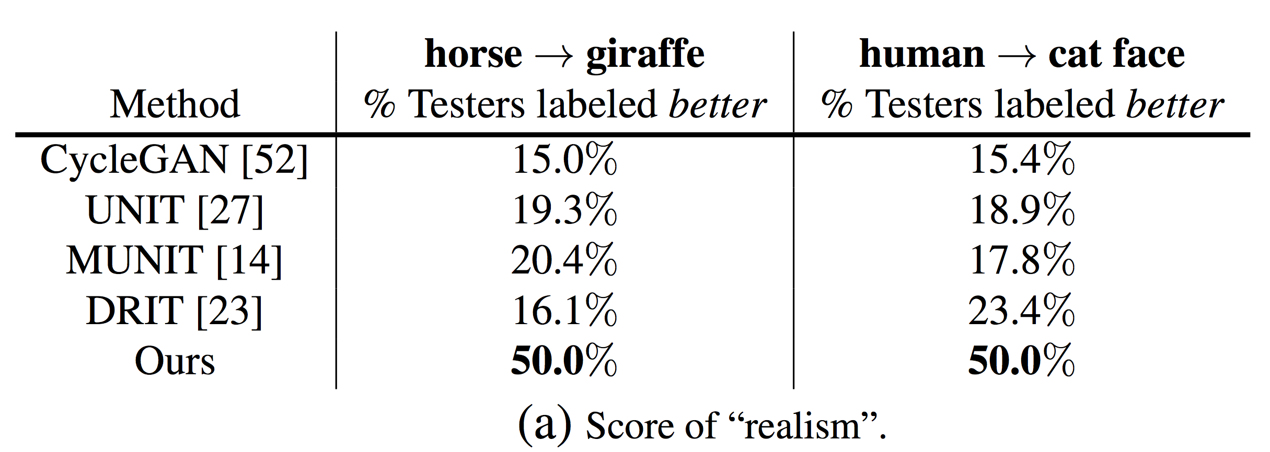
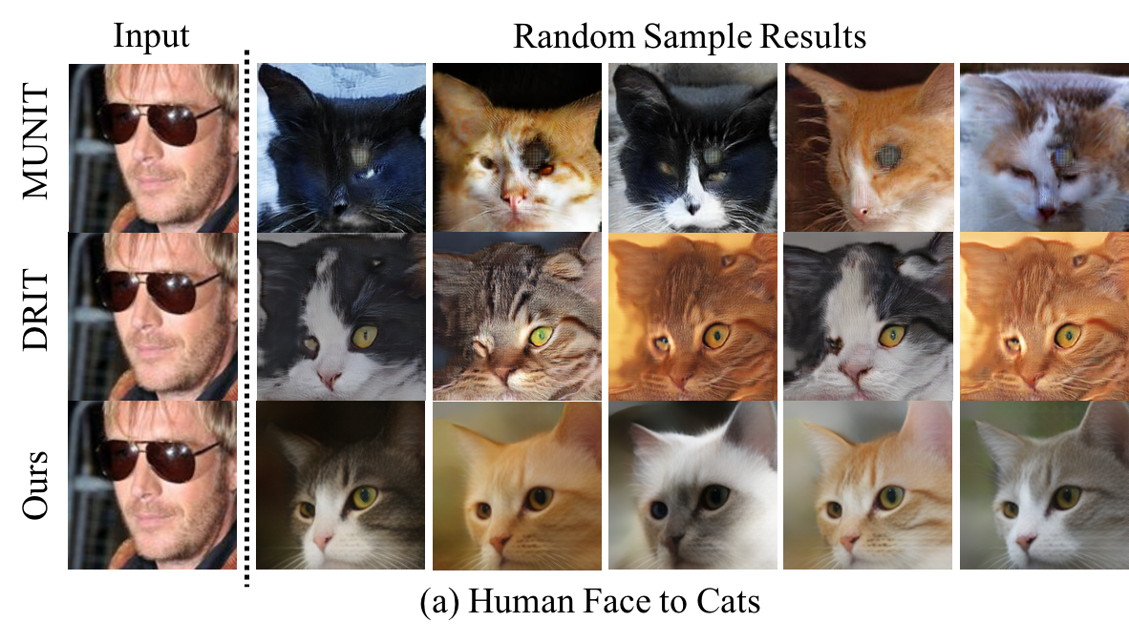
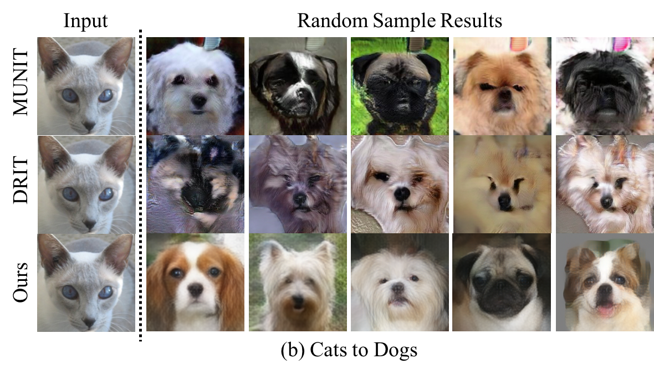
TransGaGa: Geometry-Aware Unsupervised Image-to-Image Translation
Project Page
Wayne Wu¹, Kaidi Cao², Cheng Li¹, Chen Qian¹, Chen Change Loy³
¹ SenseTime Research
² Stanford University
³ Nanyang Technological University
1. INTRODUCTION
2. METHODOLOGY
3. TRAINING
Separated training
(1)
(2)
Joint training
(3)
(4)
(5)
(6)
(7)
Motivation
Contributions
(8)
Recent works demonstrated the effectiveness in transferring local textures but shown their limitations on the translation between two domains with large geometry variations.
Performing a translation on higher semantic level with the consideration of geometry information is non-trivial.
We propose a novel framework for unsupervised image-to-image translation, which is robust to more complicated objects with large geometry variations.
Fine-disentangled latent space naturally endows our model with the ability of diverse and exemplar-guided generation.
(9)
Disentangled representation. The top-row shows the corresponding geometry heatmaps of the faces in the left-most column. We illustrate the explicitly disentangled latent space with a grid of structure&appearance swapping results.
(10)
Architecture. Our framework consists of four main components: two auto-encoders (X/Y domain) and two transformers (geometry/appearance).
Total loss
(11)
Separated training.
Joint training.
(12)
4. QUANTITATIVE COMPARISON & ABLATION
5. QUALITATIVE COMPARISON
6. QUALITATIVE ANALYSIS
Quantitative results. We use FID (lower is better) and diversity (higher is better) with LPIPS distance to evaluate the quality and diversity of the generated images.
Exemplar-guided generation. Conditional generation with different images as appearance reference.
Human perceptual study. Pairwise A/B tests on horse→giraffe and human→cat face task.
Ablation study. Fooling rate of “real vs fake”.
Comparison in geometry-preserving. Results on (a) synthesis datasets (b) real-world datasets.
Exemplar-guided generation. Conditional generation with different images as appearance reference on cat→human face, human→dog face, dog→cat face tasks.
Comparison in multi-modal generation. Results on (a) human→cat face (b) cat→dog face.
Interpolation. Linear interpolation results of geometry and appearance latent code.

